Slide 1
Pragati bus management system

Slide 2
ABSTRACT
The Bus Management System is a simple console-based application developed in C to manage bus details efficiently. It allows users to add and display bus records such as bus number, source, destination, and available seats. The system demonstrates the use of structures, functions, and arrays in C programming. This project is useful for understanding basic data handling and menu-driven program design.

Slide 3
INTRODUCTION
Transportation systems require proper management of buses and their routes. Manual record keeping is time-consuming and error-prone. This project provides a simple digital solution using C programming.
The system is designed to:
Store bus details
Display available buses
Provide a structured way of managing data
It is a beginner-level implementation of a real-world system.

Slide 4
OBJECTIVES
To implement a menu-driven program
To understand and use structures in C
To manage data using arrays
To perform operations like:
Adding bus details
Displaying records
To improve problem-solving and coding skills

Slide 5
METHODOLOGY
The system follows a simple procedural approach:
Data Structure Design
A struct Bus is created to store:
Bus Number
Source
Destination
Seats
Menu-Driven Approach
User selects options:
Add Bus
Display Bus
Exit
Functions Used
addBus() → Adds new bus details
displayBus() → Displays all records
Data Storage
Uses an array to store up to 10 bus records
Execution Flow
Loop runs until user chooses exit

Slide 6
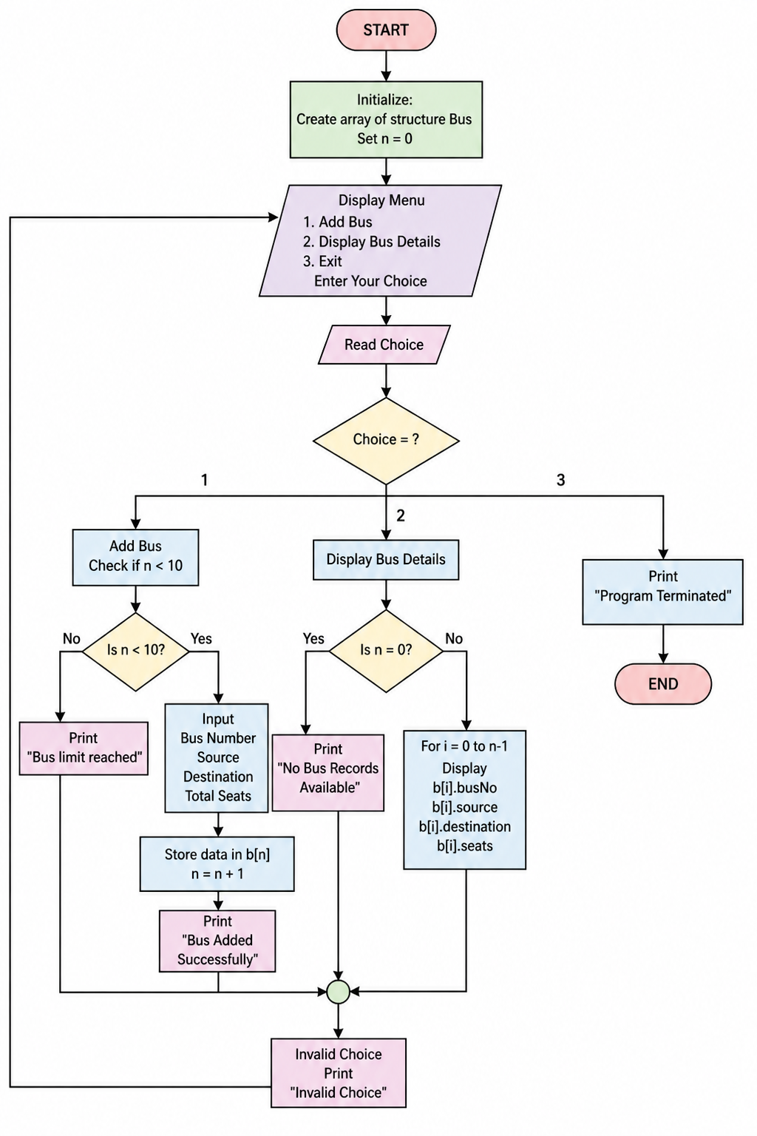
FLOWCHART

Slide 7
ALGORITHM
Start
Set number of buses n = 0
Show menu:
Add Bus
Display Bus
Exit
Enter user choice
If choice = 1:
Enter bus details (number, source, destination, seats)
Store in array
Increase n
If choice = 2:
If no data → print "No records"
Else → display all bus details
If choice = 3:
Stop program
Otherwise:
Print "Invalid choice"
Repeat steps 3–8 until user selects Exit
End

Slide 8
FUTURE SCOPE
This project can be improved by adding:
✅ Seat booking system
✅ Bus search functionality
✅ File handling (permanent storage)
✅ Login system (admin/user)
✅ GUI using advanced languages
✅ Database integration (MySQL)

Slide 9
REFERENCES
C Programming by Dennis Ritchie
Let Us C by Yashavant Kanetkar
GeeksforGeeks (C Programming Concepts)
TutorialsPoint (C Structures & Functions)

